Slide 1
Project Management with VSTS
1

Slide 2
What VSTS offers for Project Management?
Work Item tracking
Portfolio backlog
Feature
Backlog
Product Backlog Item
Bug
Task
Task
Issue tracking
Impediment

Slide 3
Portfolio backlog
“Do you like to first think big, defining your large features first, and then break down and define work as you go along?”
Portfolio Backlog
A hierarchical portfolio of Backlog Items
Features as parent items of child PBIs

Slide 4
Features vs. Backlog Items
Product Backlog Item – represents work that can be completed within one Sprint; they are broken down into tasks that need to be accomplished to complete work. PBIs are estimated to enable Sprint Planning & forecasting (velocity and burndown)
Feature - represents work that cannot be completed within a single Sprint and instead will run over a longer period of time before it is complete (think epic). Features are broken down into PBIs to fit into a single Sprint. Features are not Estimated as they are by definition large and unwieldy, instead they have a target date to help prioritize and plan Releases. Features are not used in Sprint Planning as they are too big; only the children in the form of PBIs are used for Sprint Planning and forecasting.

Slide 5
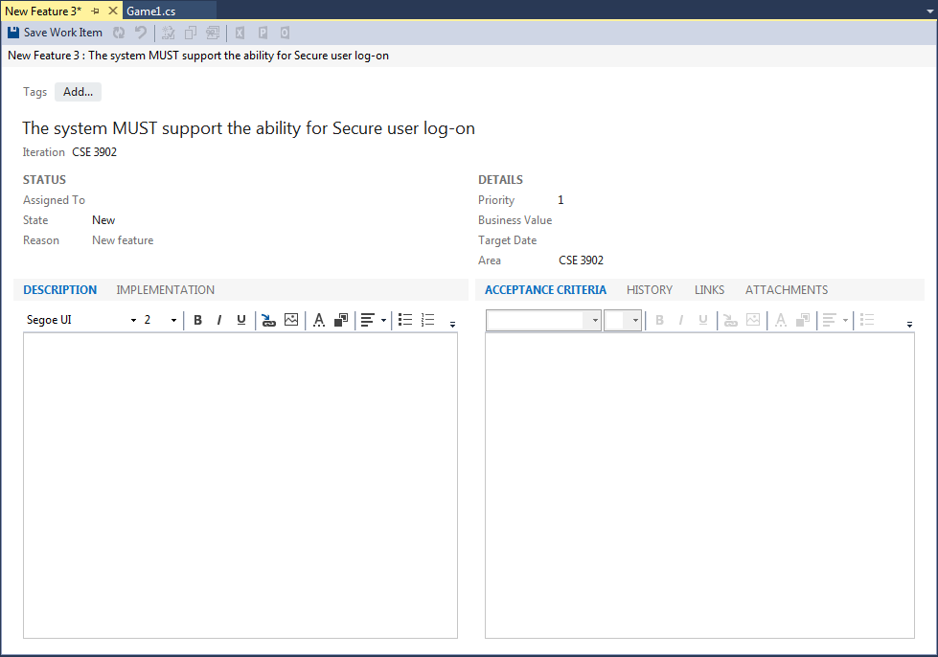
Feature Fields

Slide 6
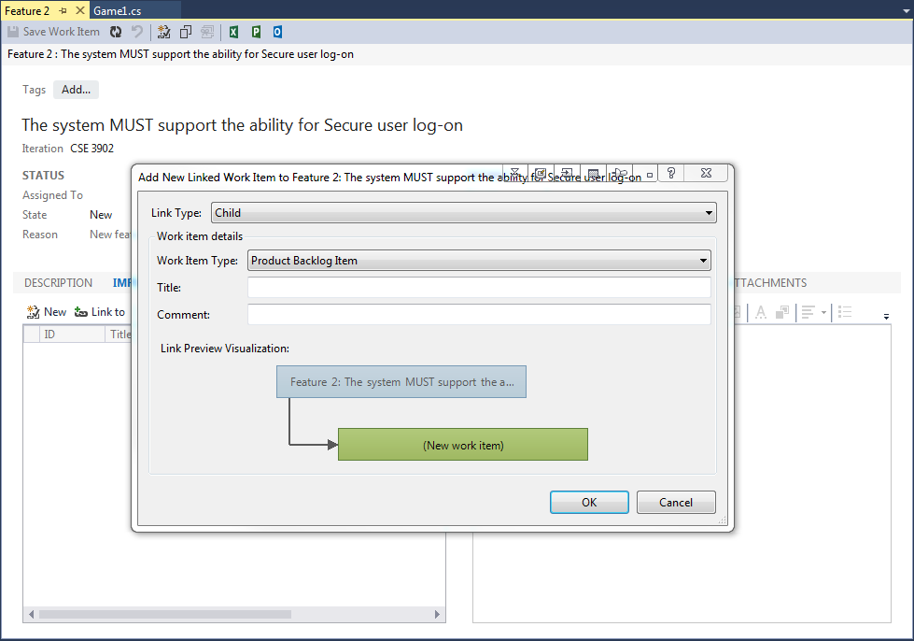
Product Backlog Item
When you define a PBI, you want to focus on the value that your customer will receive and avoid descriptions of how your team will develop the feature.

Slide 7
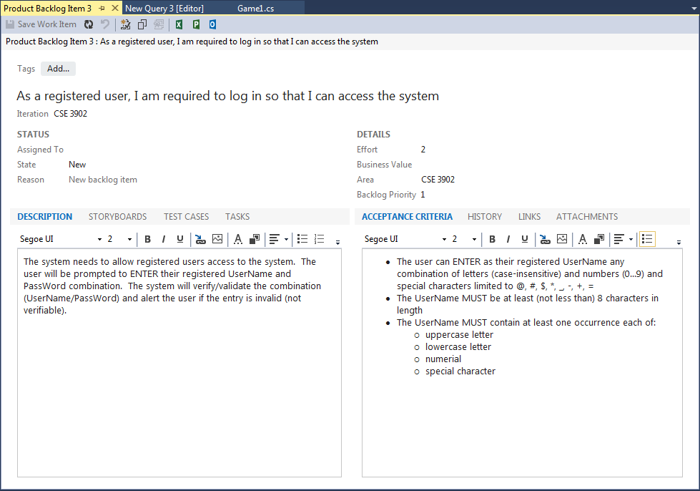
PBI Fields

Slide 8
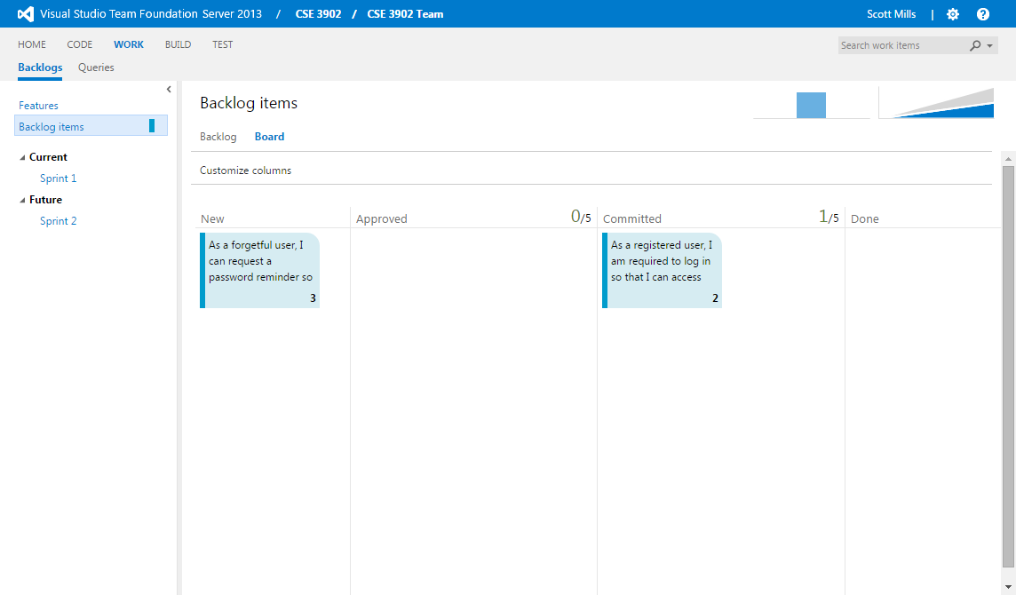
PBI Kanban Board
The product owner creates a PBI in the New state with the default reason, “New backlog item.
The product owner moves a PBI to Approved after it is sufficiently described and ready for the team to estimate the level of effort. Most of the time, items near the top of the Product Backlog are in the Approved state, while items toward the middle and bottom are in a New state.
The team updates the status to Committed when they decide to complete the work during the sprint,
A PBI is moved to Done state when the team has completed all its associated tasks and the product owner agrees that the PBI has been implemented according to the Acceptance Criteria.

Slide 9
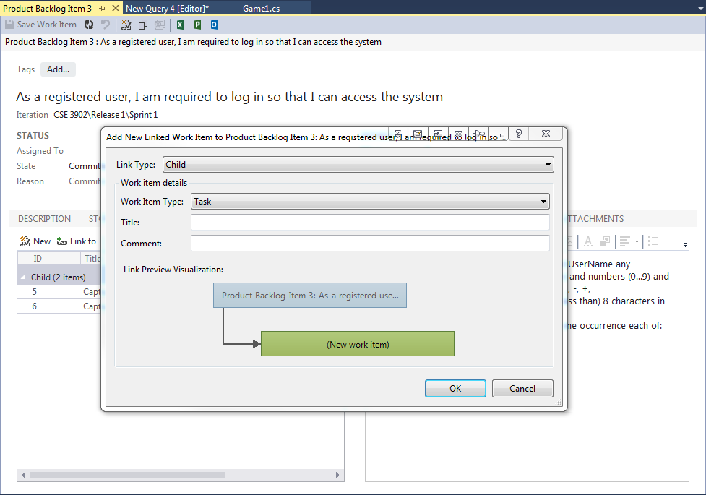
Assigning Tasks to PBI
Using Scrum, teams forecast work and define tasks at the start of each Sprint, and each team member performs a subset of those tasks. Tasks can include development, testing and other kinds of work. For example, a developer role can define tasks to implement PBIS and a tester role can define tasks to write and run test cases.

Slide 10
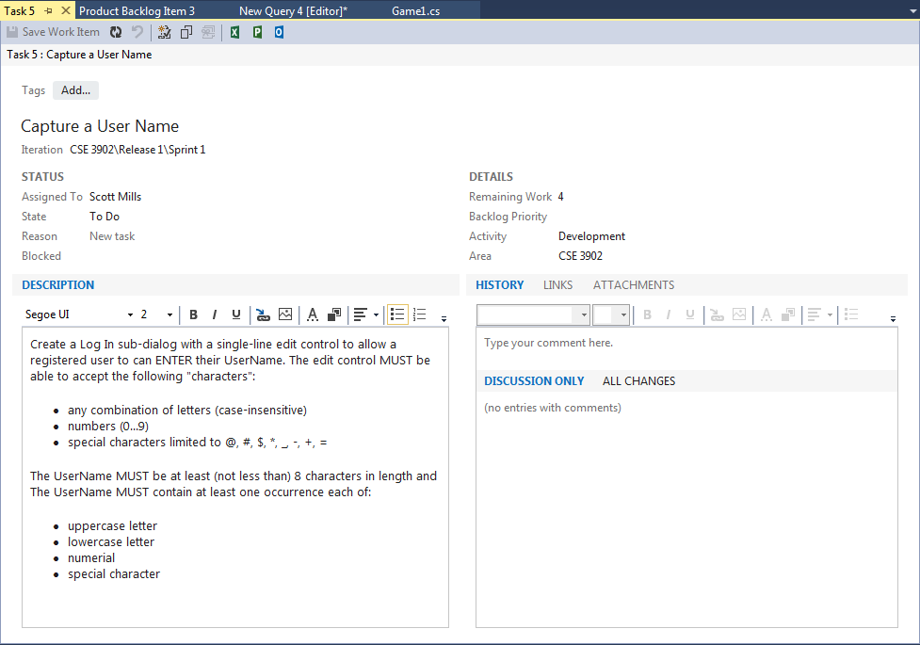
Task Fields
Remaining work: This field should be updated repeatedly by developers! After DONE status, this field is disabled.

Slide 11
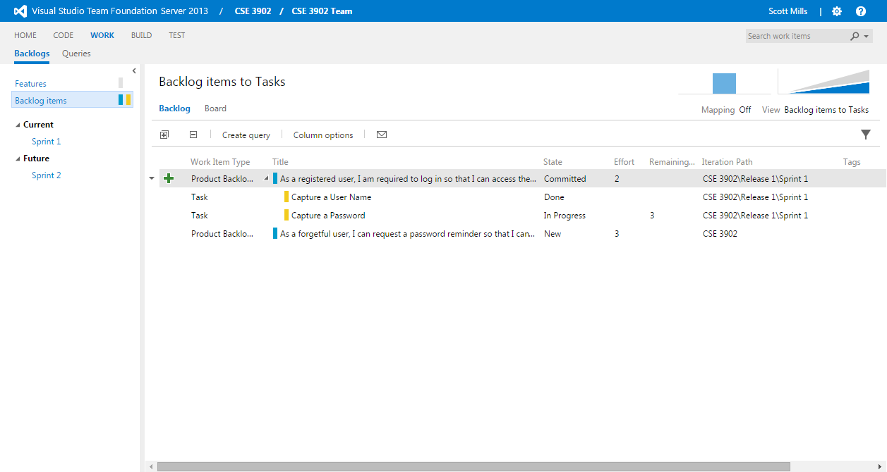
Backlog Items to Tasks

Slide 12
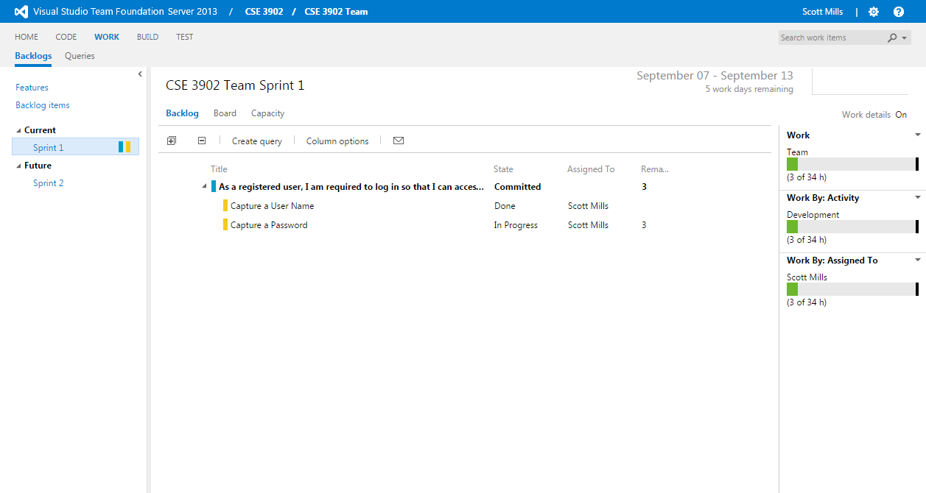
Sprint in VSTS

Slide 13
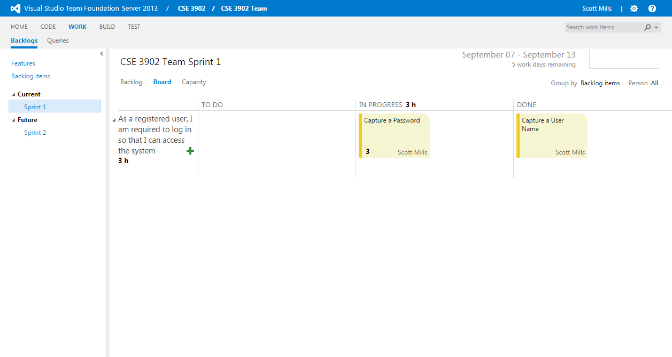
Sprint Kanban Board

Slide 14
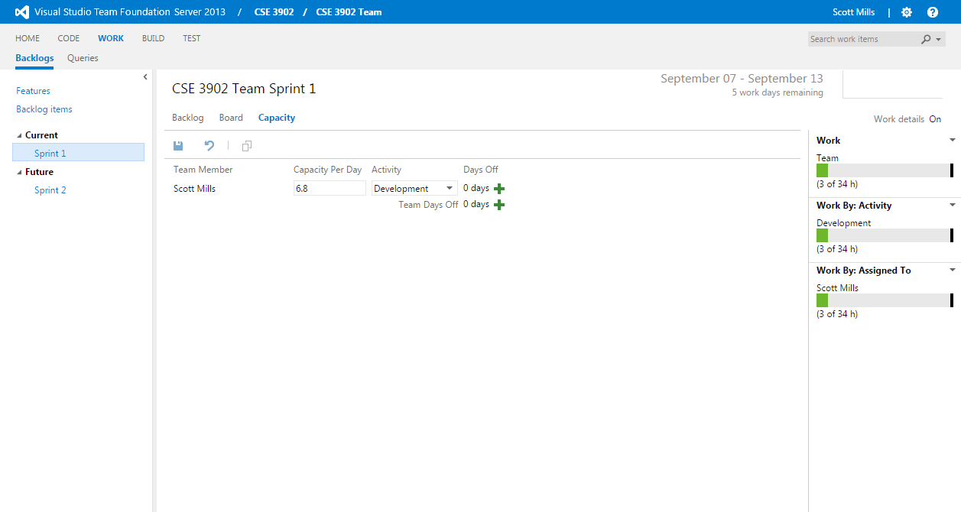
Managing Sprint Members

Slide 15
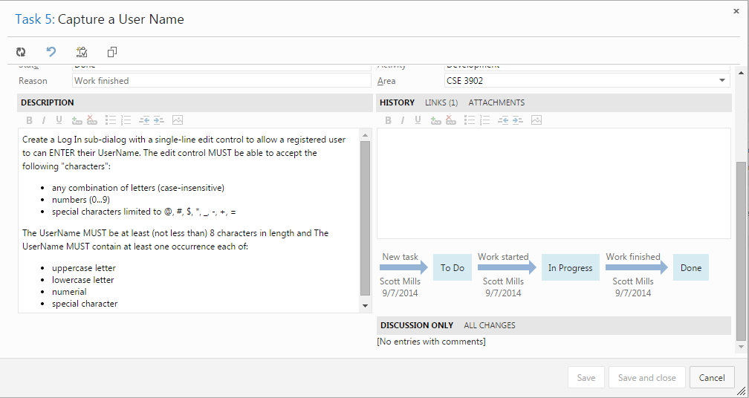
Tracking an Item

Slide 16
?

Slide 17
References
Hossein, Sarahar. “Managing software projects with Team Foundation Server 2013 in Agile Scrum”
NSilverBullet. “Features help us plan work better in Team Foundation Server Scrum process”

